Slide 1
Secure Electronic Transactions (SET)
open encryption & security specification
to protect Internet credit card transactions
developed in 1996 by Mastercard, Visa etc
not a payment system
rather a set of security protocols & formats
secure communications amongst parties
trust from use of X.509v3 certificates
privacy by restricted info to those who need it

Slide 2
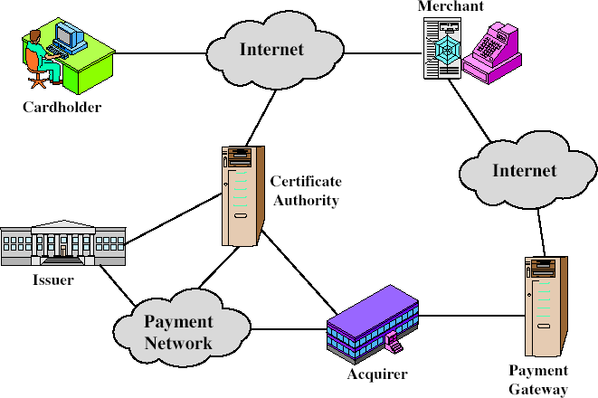
SET Components

Slide 3
SET Transaction
customer opens account
customer receives a certificate
merchants have their own certificates
customer places an order
merchant is verified
order and payment are sent
merchant requests payment authorization
merchant confirms order
merchant provides goods or service
merchant requests payment

Slide 4
Dual Signature
customer creates dual messages
order information (OI) for merchant
payment information (PI) for bank
neither party needs details of other
but must know they are linked
use a dual signature for this
signed concatenated hashes of OI & PI

Slide 5
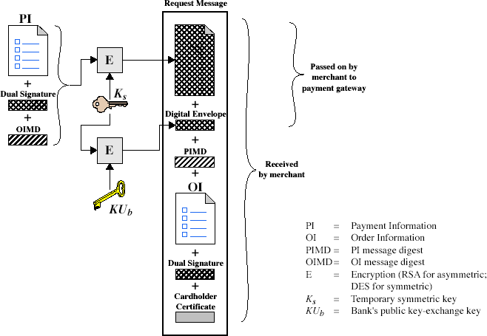
Purchase Request – Customer

Slide 6
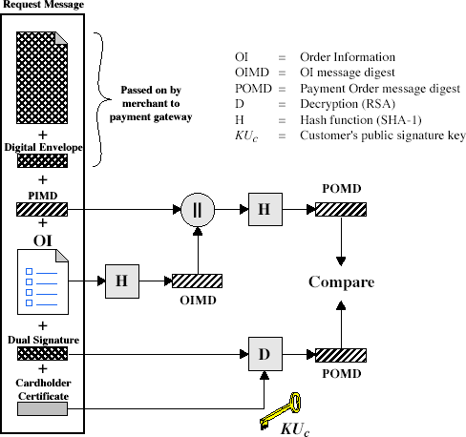
Purchase Request – Merchant

Slide 7
Purchase Request – Merchant
verifies cardholder certificates using CA sigs
verifies dual signature using customer's public signature key to ensure order has not been tampered with in transit & that it was signed using cardholder's private signature key
processes order and forwards the payment information to the payment gateway for authorization (described later)
sends a purchase response to cardholder

Slide 8
Payment Gateway Authorization
verifies all certificates
decrypts digital envelope of authorization block to obtain symmetric key & then decrypts authorization block
verifies merchant's signature on authorization block
decrypts digital envelope of payment block to obtain symmetric key & then decrypts payment block
verifies dual signature on payment block
verifies that transaction ID received from merchant
matches that in PI received (indirectly) from customer
requests & receives an authorization from issuer
sends authorization response back to merchant

Slide 9
Payment Capture
merchant sends payment gateway a payment capture request
gateway checks request
then causes funds to be transferred to merchants account
notifies merchant using capture response

Slide 10
Summary
have considered:
need for web security
SSL/TLS transport layer security protocols
SET secure credit card payment protocols

